Slide 1

Chapter 3: Metallic, ionic and covalent structure and bonding

Slide 2
Bonding and the periodic table
The number of electrons in the valence shells can be determined from the periodic table.
Elements in the same group have the same number of valence electrons.
Atoms tend to form chemical bonds to obtain a filled valence shell and become chemically stable.

Slide 3
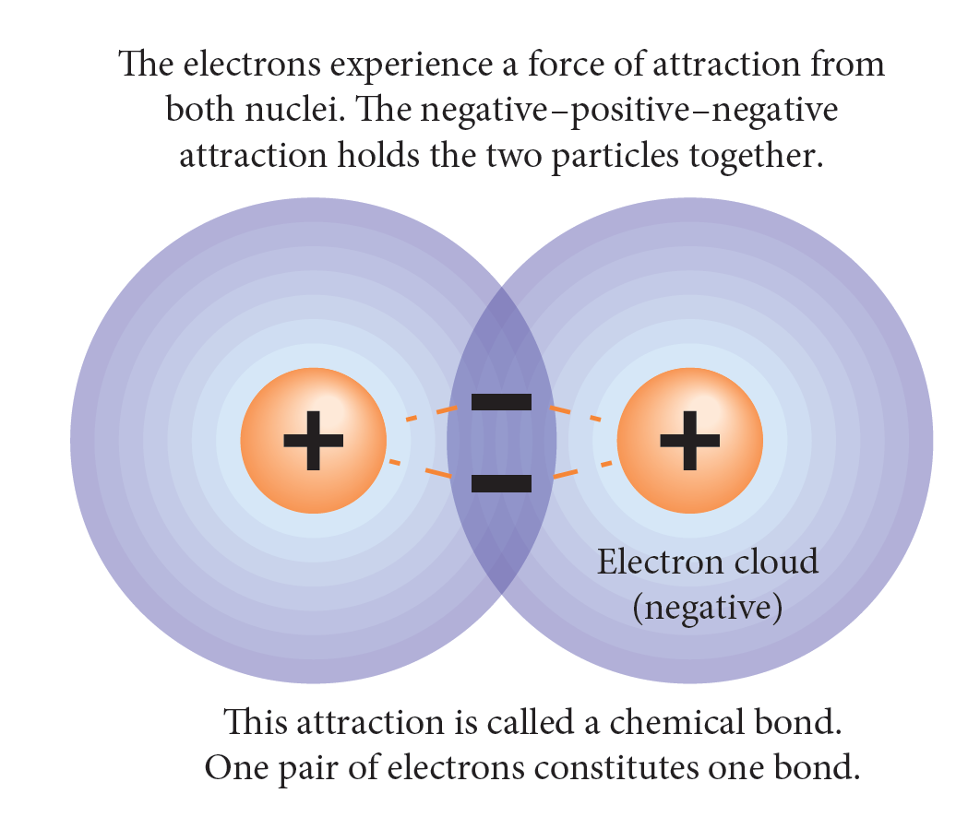
Chemical bonds are due to the electrostatic force of attraction between positive and negative charges in participating atoms.
Bonding

Slide 4
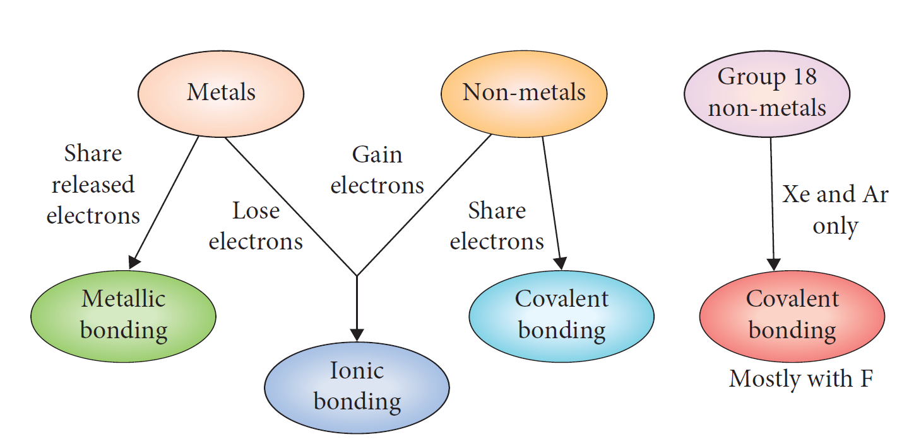
Three types of bonds

Slide 5
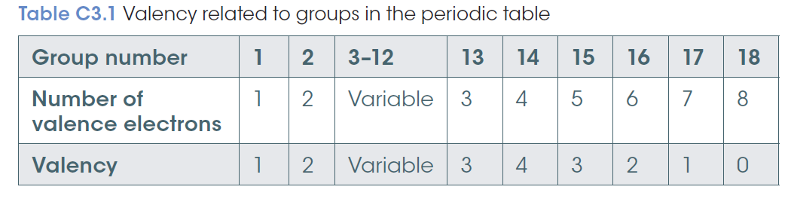
Calculating valency
Valency is the combining power of an atom.
It is equal to the number of hydrogen atoms that atom could combine with or displace from a compound.
Hydrogen has a valency of 1

Slide 6
Worked example: what would be a possible ratio?
Between oxygen and nitrogen?
Determine valency
O (8-6 ) = needs 2
electrons
N (8-5) = needs 3
electrons
Lowest common multiple
6
2N: 3O
Carbon and chlorine?
C has ___ needs ___
Cl has ___ needs ___

Slide 7
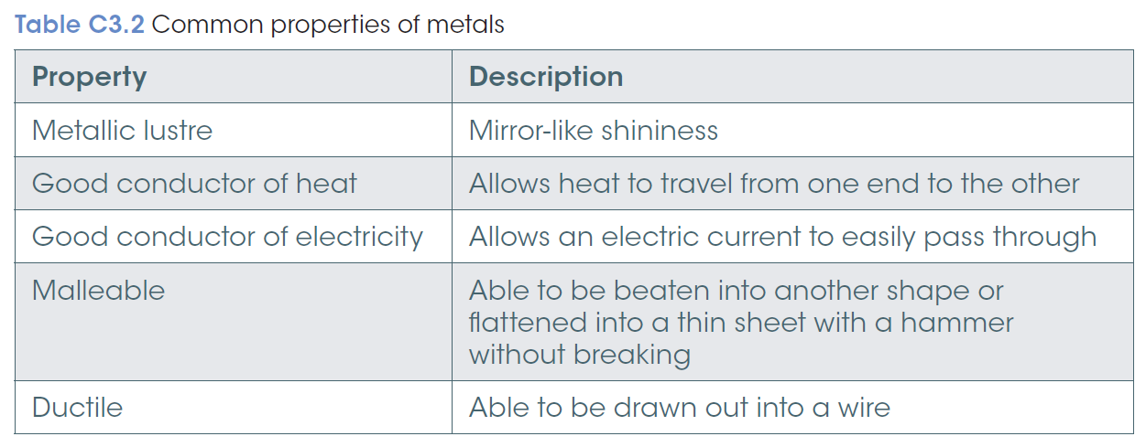
Metals, bonding and properties
Metals make up 75% of the elements.
Some properties vary from metal to metal:
e.g. most metals are hard and can not be scratched: except gold, lead and calcium.

Slide 8
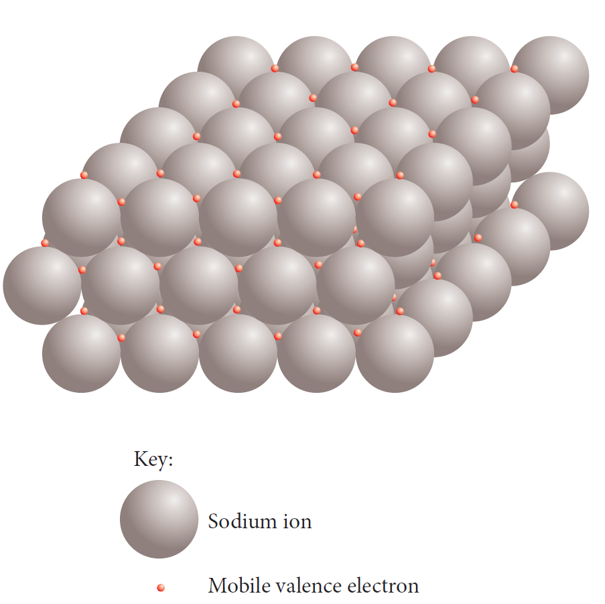
Metallic bonding
Metallic bonding is the electrostatic forces of attraction between cations and the electrons that are free to move within the regular lattice structure of a metal.

Slide 9
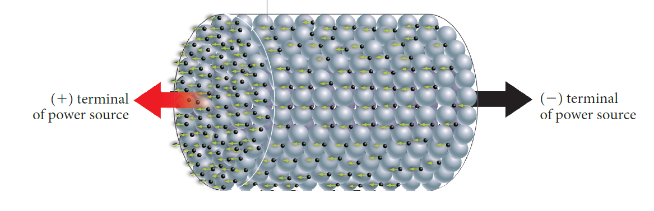
Explaining properties of metals
Good conductors of electricity.
The highly mobile electrons within the lattice are free to move.
When attached to a power supply the electrons will move to the positive terminal.

Slide 10
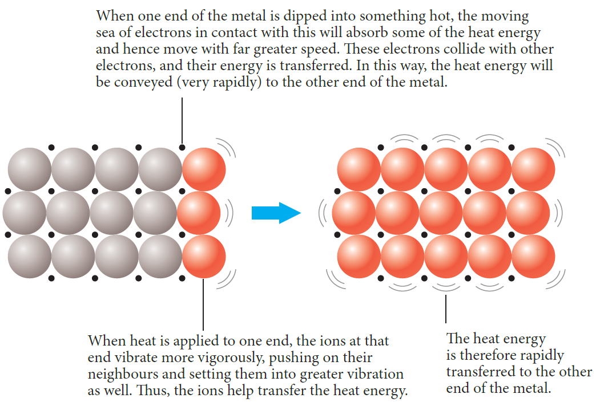
Explaining properties of metals
Good conductors of heat.
The mobile electrons acquire energy from the heat source and move with far greater speed. They collide with other electrons transferring energy.
Ions will vibrate vigorously, pushing their neighbours to vibrate as well, rapidly transferring the heat energy.

Slide 11
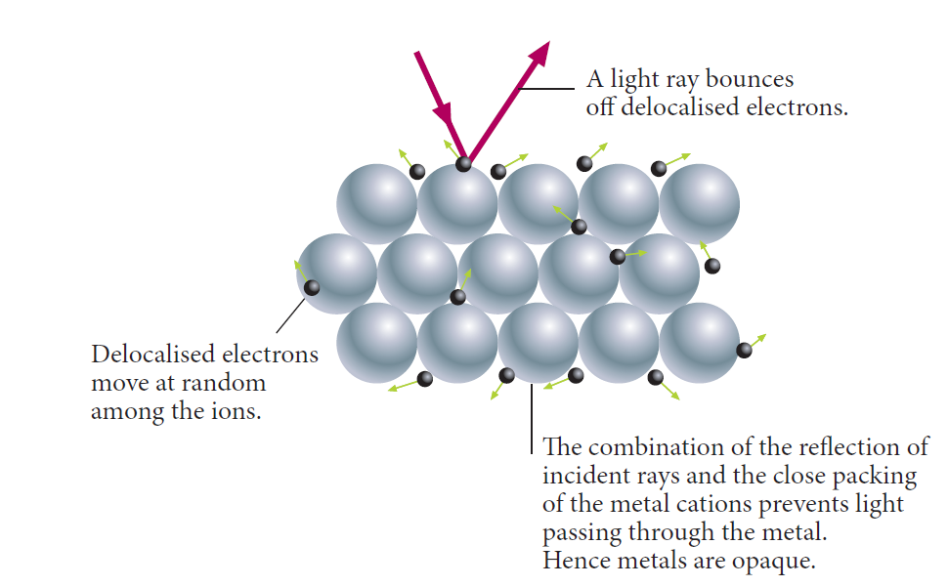
Explaining properties of metals
Lustrous
Light rays reflect off the delocalised electrons close packing of the metal cations prevent light from passing through making the metal opaque.

Slide 12
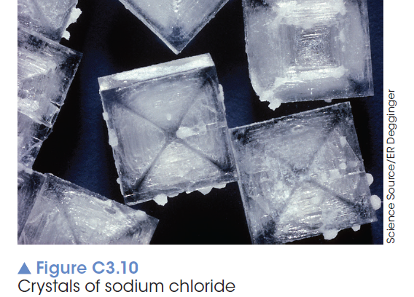
Properties of ionic compounds and ionic bonding
Hard and brittle
not easily scratched but will shatter when impacted on by a force
non-conductors of electricity in the solid state
good conductors when molten or in a aqueous state
High melting and boiling points

Slide 13
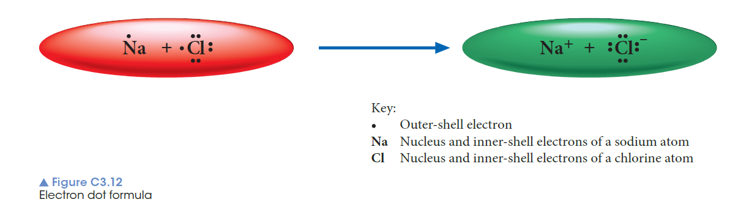
Formation of ions and ionic bonding
Ions are atoms or groups of atoms that are electrically charged due to an imbalance in the number of electrons and protons.
Ionic bonding is due to the electrostatic force of attractions between oppositely charged ions.

Slide 14
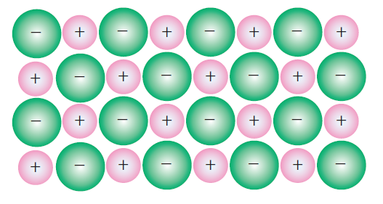
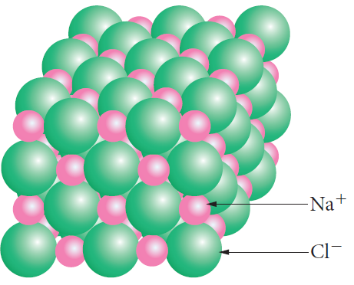
An ionic substance consists of an orderly array of positive and negative ions.

Slide 15
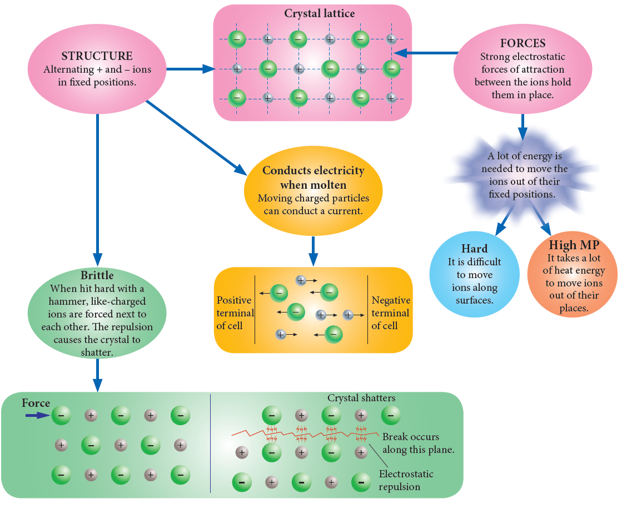
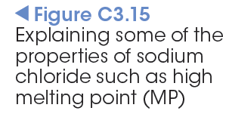
Explaining properties of ionic compounds

Slide 16
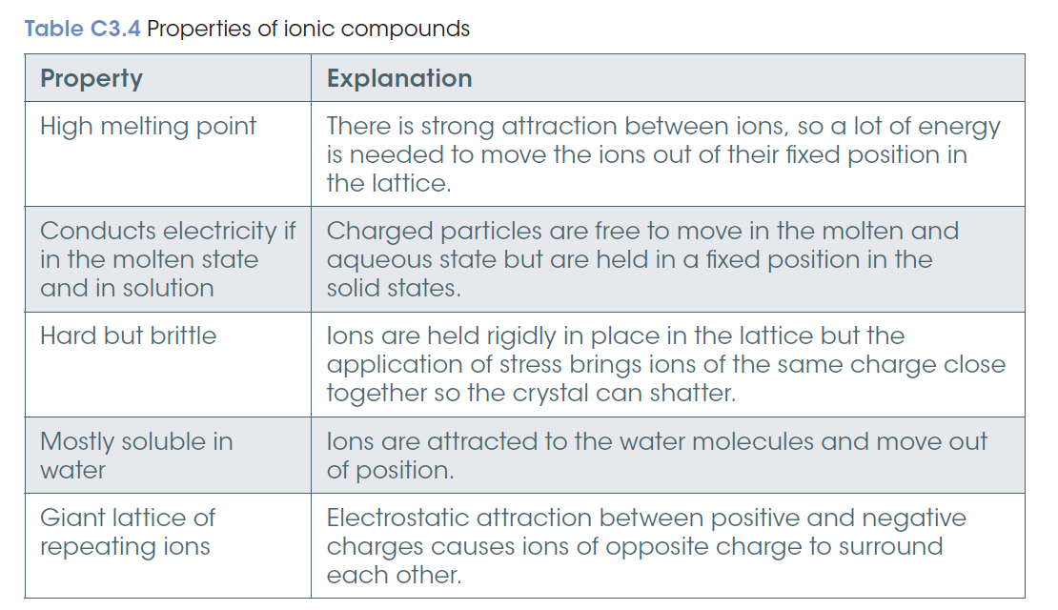

Slide 17
Names and formulas of ionic compounds
Positive ion
Negative ion
Always listed first.
The name of positive ion is the same as the element.
Listed second.
The name of the non-metal parent element is replaced with ide
e.g. Chlorine ---chloride

Slide 18
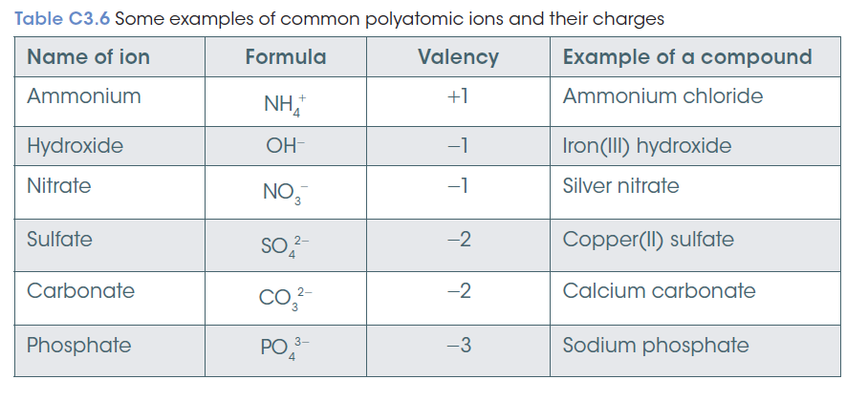

Slide 19
Properties of covalent compounds and covalent bonding
Covalent substances may be molecules or networks.
A covalent molecular substance is composed of discrete molecules.
low melting point, soft, usually liquid or gases
A covalent network substance is a three-dimensional network.
hard, very high melting points, solids
Non-metals show a lot of variation in their properties so tend to be classified by what they cannot do.

Slide 20
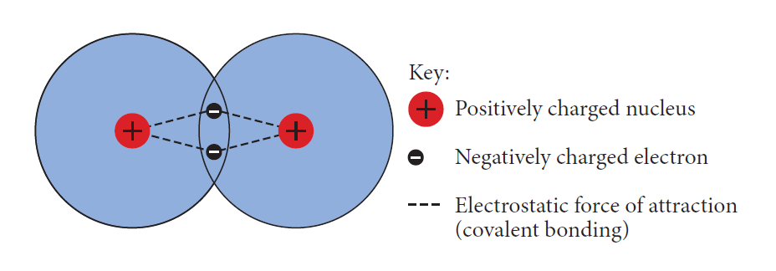
Covalent bonding
The electrostatic forces of attraction between electrons and the nuclei of more than one atom
The shared electrons are called a bonding pair and effectively the atoms have a filled valence shell.

Slide 21
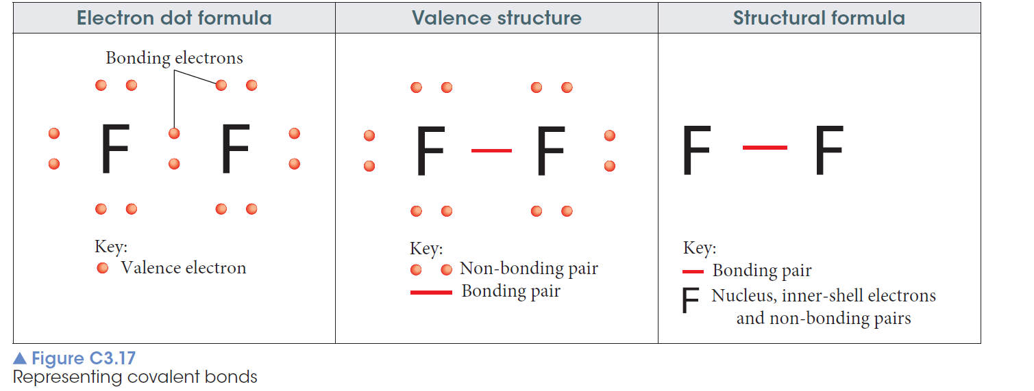
Representing covalent bonds

Slide 22
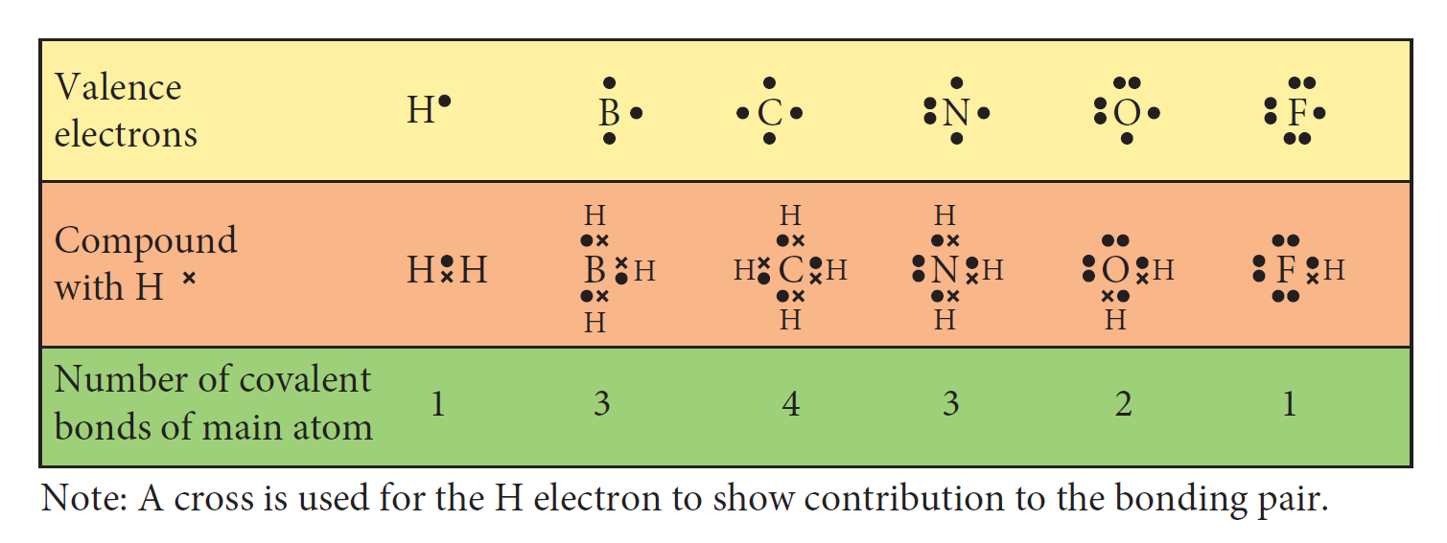
Covalent bonds and the periodic table

Slide 23
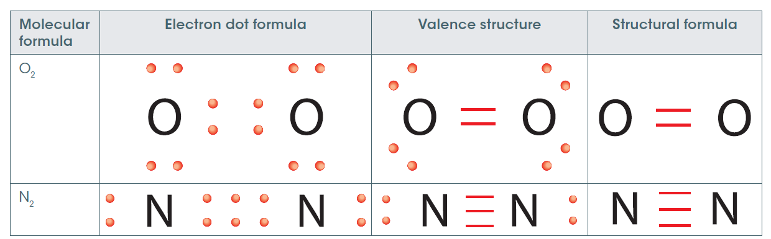
Multiple covalent bonds
When atoms share more than one pair of electrons a multiple covalent bond will form.
Double covalent bond:
two pairs of electrons are shared
Triple covalent bond:
stronger -three pairs of electrons are shared.

Slide 24
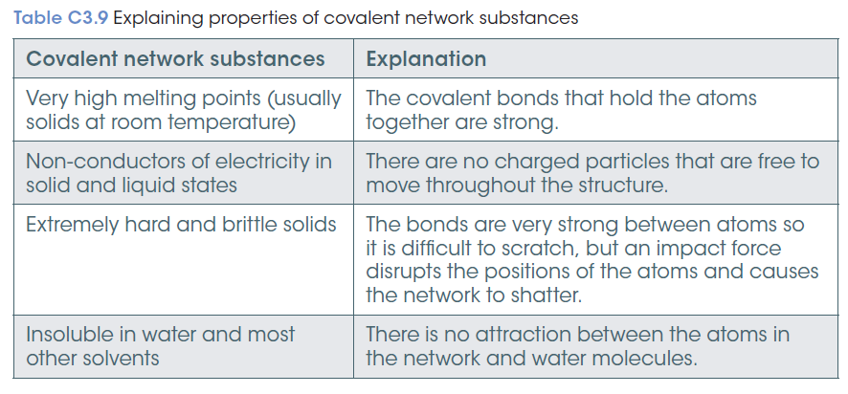
Covalent network substances

Slide 25
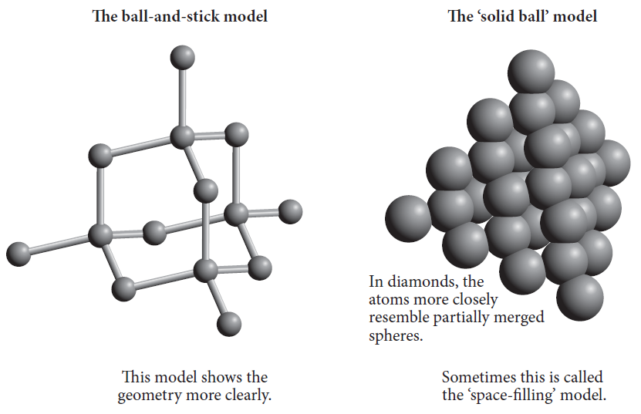
Allotrope of carbon: diamond
3D network
high melting point
non-conductor of electricity
insoluble
unreactive

Slide 26
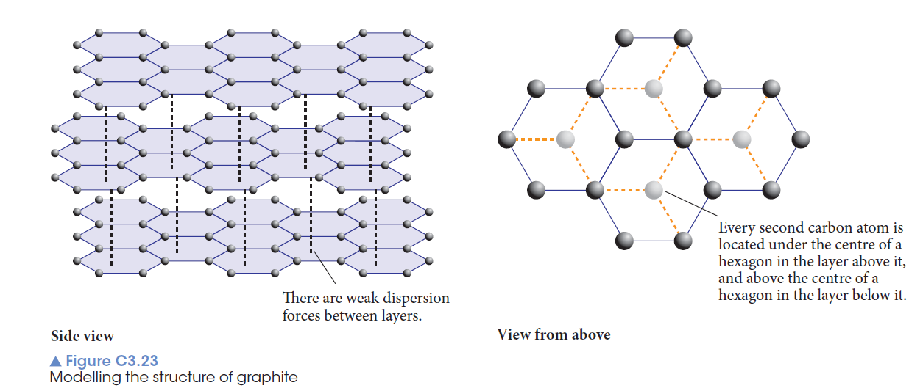
Allotrope of carbon: graphite
high melting point
good conductor of electricity
insoluble
soft

Slide 27
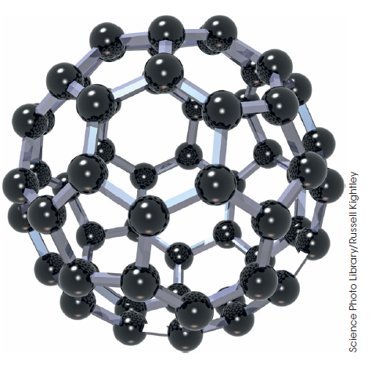
Allotrope of carbon: fullerenes
soft, slippery
do not conduct electricity
insoluble in water
typically low melting points
not a covalent network substance

Slide 28
Names and formulas of covalent compounds
To name covalent compounds:
Use the element name for the first element and change the end of the second element to –ide
The first named element is the one that is furthest to the left in the periodic table
For element in the same group the one lower down the group is named first
Exception is when O is bonded to Cl, Br, or I – oxygen is named last

Slide 29
Names and formulas of covalent compounds
The number of atoms of each type is given by the prefixes in front of each part of the name (though mono may be omitted from the first named element).
Sometimes the common names are used e.g. dihydrogen monoxide is called water
Nitrogen trihydride is called ammonia

Slide 30
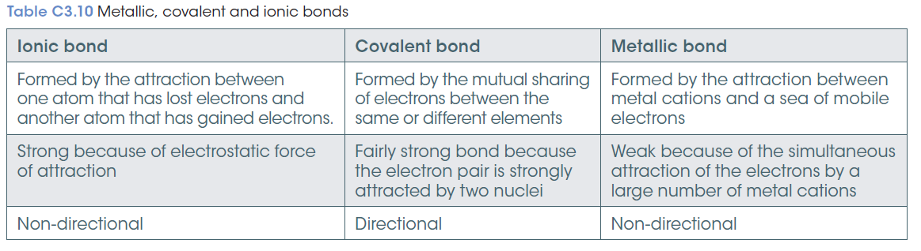
Comparing bonding and properties

Slide 31
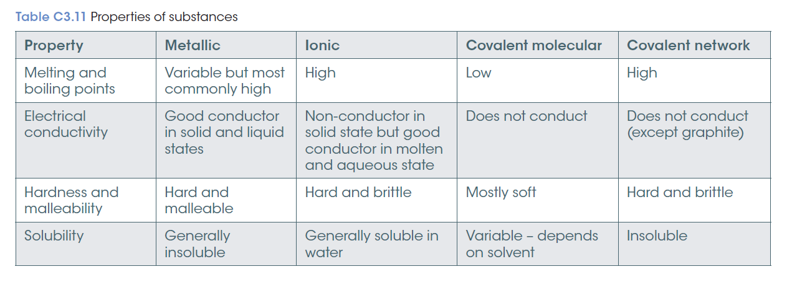
Comparing bonding and properties

